Slide 1
Operating System Overview
Chapter 2

Slide 2
Operating System Objectives
Convenience
  Makes the computer more convenient to use
Efficiency
  Allows computer system resources to be used in an efficient manner
Ability to evolve
  Permit effective development, testing, and introduction of new system functions without interfering with service (open system architectures)

Slide 3
Services Provided by the OS
Program development (e.g. editors/debuggers)
Program execution (e.g. compilers, loaders, etc.)
Access to I/O devices (device drivers)
Controlled access to files (file manager)
Error detection and response (hardware/software errors)
Data collection (collect statistics / monitor performance)

Slide 4
Early Operating Systems
Serial Processing (40’s to mid-50’s)
  No operating system
  display lights / toggle switches, input device, and printer
  need to schedule time manually
  each time: load the compiler, source program, save compiled program, load / link / run
Simple Batch Systems
  Monitor: Software that controls the running programs (always resident in memory)
    Batch jobs together
    Program branches back to monitor when finished
Job Control Language (JCL)
  a type of programming language which provides instructions to the monitor (e.g. compiler to use; where does the data section start, etc. )

Slide 5
Hardware Features Added Later
Memory protection
  do not allow the memory area containing the monitor to be altered
Timer
  prevents a job from monopolizing the system
Privileged instructions (e.g. I/O)

Slide 6
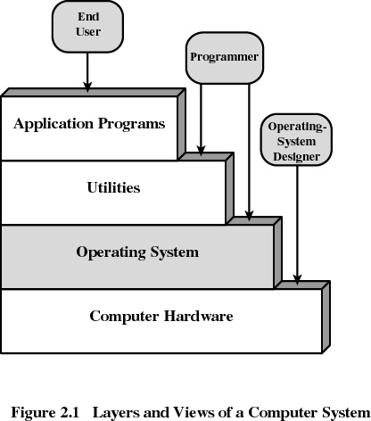
Layers of Computer System

Slide 7
Basic OS Organization
File
Manager
Process &
Resource
Manager
Memory
Manager
Device
Manager
Processor(s)
Main Memory
Devices

Slide 8
Kernel
Portion of operating system that is in main memory
Contains most-frequently used functions
Also called the nucleus

Slide 9
Typical UNIX Organization
Process
Process
Libraries
User
Process
Supervisor
Kernel
Device Drivers
Processor(s)
Main Memory
Devices

Slide 10
Unix Organization
Process
Libraries
Process
Process
System Call Interface
File
Manager
Deadlock
Process
Description
Protection
Synchronization
Device
Manager
Memory
Manager
Resource
Manager
Scheduler
Resource
Manager
Resource
Manager
Monolithic Kernel
Devices
Memory
CPU
Other H/W

Slide 11
Microkernel Organization
Process
Process
Libraries
User
Process
Server
Server
Server
Device Drivers
Supervisor
Microkernel
Processor(s)
Main Memory
Devices

Slide 12
Microkernels
Modern OS s use microkernel approach
Small operating system core
Contains only essential OS functions
    memory management
    interprocess communication (IPC)
    basic scheduling
Many services traditionally included in the operating system are now external subsystems
  device drivers
  file systems
  windowing system
  security services

Slide 13

Uniprogramming
Processor must wait for I/O instruction to complete before preceding

Slide 14
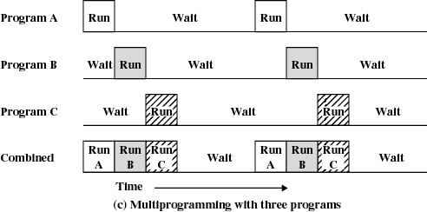
Multiprogramming
When one job needs to wait for I/O, the processor can switch to the other job

Slide 15
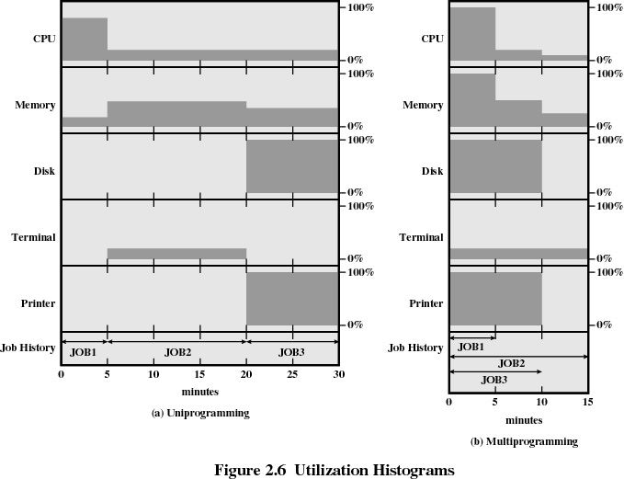

Slide 16
Example
JOB1 JOB2 JOB3
Type of job Heavy Heavy I/O Heavy I/O
compute
Duration 5 min. 15 min. 10 min.
Memory required 50K 100 K 80 K
Need disk? No No Yes
Need terminal No Yes No
Need printer? No No Yes

Slide 17
Effects of Multiprogramming
Uniprogramming Multiprogramming
Processor use 22% 43%
Memory use 30% 67%
Disk use 33% 67%
Printer use 33% 67%
Elapsed time 30 min. 15 min.
Throughput rate 6 jobs/hr 12 jobs/hr
Mean response
time 18 min. 10 min.

Slide 18
Time Sharing
Using multiprogramming to handle multiple interactive jobs
Processor’s time is shared among multiple users
Multiple users simultaneously access the system through terminals

Slide 19
Batch Multiprogramming vs. Time Sharing
 | Batch Multiprogramming | Time Sharing
Principal objective | Maximize processor use | Minimize response time
Source of directives to operating system | Job control language commands provided with the job | Commands entered at the terminal

Slide 20
Major Achievements
Processes
Memory Management
Information protection and security
Scheduling and resource management
System structure

Slide 21
Processes
A program in execution
An instance of a program running on a computer
The entity that can be assigned to and executed on a processor
A unit of activity characterized by a single sequential thread of execution, a current state, and an associated set of system resources

Slide 22
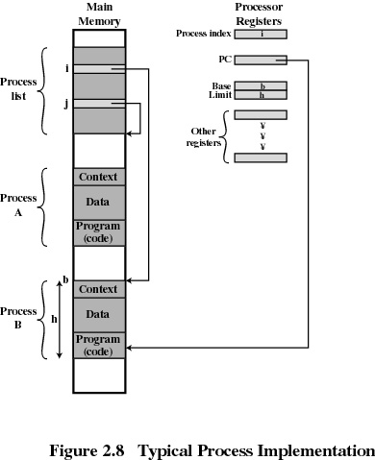
Process
Consists of three
components
  executable program
  associated data
  execution context
    information OS needs to manage the process

Slide 23
Memory Management
Process isolation
(prevents interference from other programs)
Automatic allocation and management
(transparent to the programmer)
Support for modular programming
(e.g. dynamic process creation and elimination)
Protection and access control for sharing
Long-term storage

Slide 24
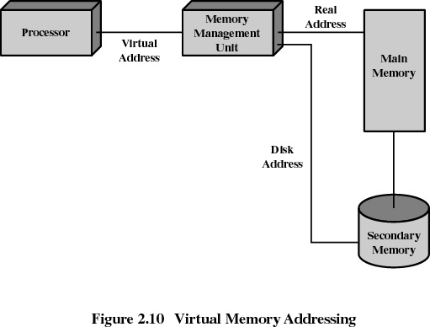
Virtual Memory Addressing

Slide 25
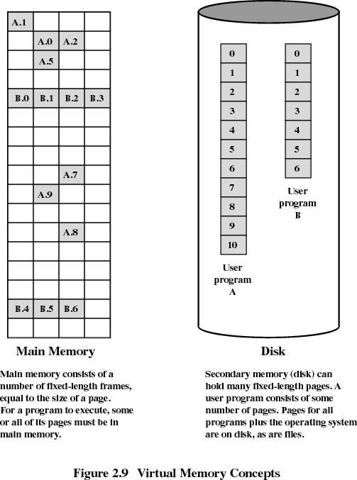
Paging
process is divided into a number of fixed-size blocks, called pages
Virtual address is a page number and an offset within the page
Each page may be located anywhere
in main memory

Slide 26
Scheduling and Resource Management
Fairness
  give equal and fair access to all processes
Differential responsiveness
  discriminate between different classes of jobs
Efficiency
  maximize throughput, minimize response time, and accommodate as many users as possible

Slide 27
System Structure
Layered architecture - design the OS as a series of levels where each level is performing a related subset of functions
Each layer provides services to the layer above and relies on the functions provided by the layer below
A change in one layer should not effect other layers (hopefully!)
Modular design - decomposes a problem into a number of more manageable subproblems

Slide 28
Model of a Hierarchical OS
Level Name Objects Example Operations
7 Virtual Memory Segments, pages Read, write, fetch
6 Local secondary Blocks of data, device Read, write, allocate, free
store channels
5 Primitive processes Primitive process, Suspend, resume, wait, signal
semaphores
4 Interrupts Interrupt-handling Invoke, mask, unmask, retry programs
3 Procedures Procedures, call stack, Mark stack, call, return
display
2 Instruction Set Evaluation stack, micro- Load, store, add, subtract
program interpreter, branch
scalar and array data
1 Electronic circuits Registers, buses, etc. Clear, transfer, activate
**Shaded area ➔ Hardware

Slide 29
Model of a Hierarchical OS
Level Name Objects Example Operations
13 Shell User programming Statements in shell language
environment
12 User processes User processes Quit, kill, suspend, resume
11 Directories Directories Create, destroy, attach, detach,
search, list
10 Devices External devices, such Open, close,
as printer, displays read, write
and keyboards
9 File system Files Create, destroy, open, close
read, write
8 Communications Pipes Create, destroy, open. close,
read, write

Slide 30
Microkernels
Modern OS s use microkernel approach
Small operating system core
Contains only essential OS functions
    memory management
    interprocess communication (IPC)
    basic scheduling
Many services traditionally included in the operating system are now external subsystems
  device drivers
  file systems
  windowing system
  security services

Slide 31
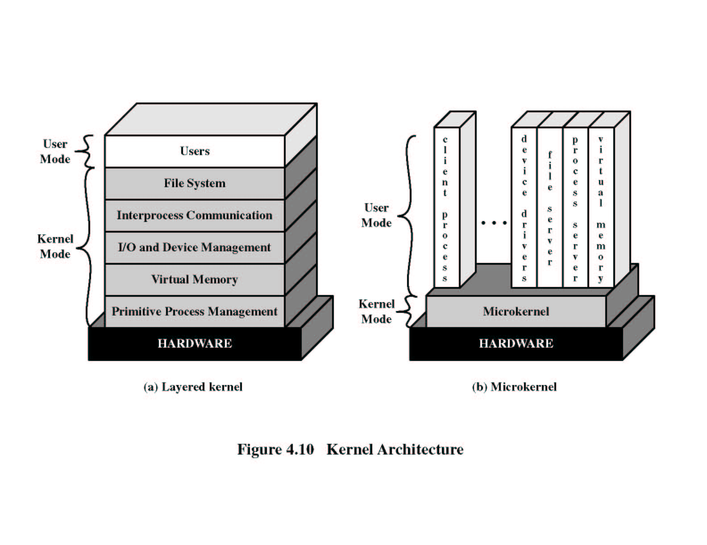
Layered vs. Microkernel

Slide 32
Benefits of a Microkernel Organization
Uniform interface
  All services are provided by means of message passing
Extensibility and Flexibility
  New features added
  Existing features can be subtracted
Portability
  Changes needed to port the system to a new processor is in the microkernel - not in the other services
Reliability
  Modular design
  Small microkernel can be rigorously tested

Slide 33
Characteristics of Modern OS s
Multithreading
  processes divided into threads that can share data and run simultaneously
Symmetric multiprocessing
  multiple PEs share same main memory and I/O facilities
Distributed OS
  provides the illusion of a single primary and secondary memory; has a distributed file system
Object-oriented design
  used for adding modular extensions to a small kernel
  enables programmers to customize an OS easily

Slide 34
Windows 2000
Exploits the power of today’s 32-bit microprocessors
Provides full multitasking in a single-user environment
Client/Server computing
Modular structure for flexibility
Executes on a variety of hardware platforms
Supports applications written for a variety of other operating systems

Slide 35
Windows 2000 Organization
Modified microkernel architecture
  Not a pure microkernel
  Many system functions outside of the microkernel run in kernel mode
Any module can be removed, upgraded, or replaced without rewriting the entire system

Slide 36
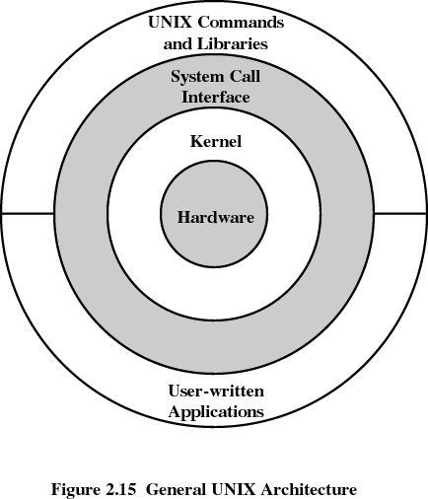
UNIX

Slide 37
UNIX
Hardware is surrounded by the OS which is called the kernel
Comes with a number of user services and interfaces
    shell
    C compiler
Modern UNIX systems
  System V Release 4 (SVR4)
  4.4BSD
  Solaris 2.x (SUN workstations)
  Linux

